Slide 1

Understanding Plagiarism
Why it matters, what it looks like, and how to avoid it — a guide for college students.

Slide 2


Ideas Are Currency
In college, your ideas — and the ideas of others — have real value. When someone writes a book, coins a theory, or crafts an argument, that work belongs to them.
Plagiarism is the act of using someone else's words or ideas without giving them credit. At its core, it is intellectual theft — taking something valuable without permission or acknowledgment.
Colleges take plagiarism seriously because it undermines trust, fairness, and the entire purpose of learning.

Slide 3
The 4 Types of Plagiarism
Intentional
Accidental
Deliberately copying someone else's work and submitting it as your own. This is the most serious form.
Forgetting to cite a source or misunderstanding citation rules. Intent doesn't eliminate responsibility.
Patchwork
3
Self-Plagiarism
Stitching together phrases from multiple sources without proper citation — even if words are slightly changed.
Reusing your own previous work for a new assignment without permission. Your old work still needs to be cited.

Slide 4
REMIX CULTURE
Remix Culture is when you are Building on Others' Ideas
Human creativity has always involved borrowing, transforming, and building on what came before. Music samples, fan fiction, parody — these are all forms of remix culture.
But remix culture does not mean anything goes. The key difference is acknowledgment and transformation — giving credit and adding something new.
E.g. A dancer creates a series of moves for an artist - those individual moves are then remixed into different combination on a TikTok for a different song - Who owns the materials at that point?

Slide 5
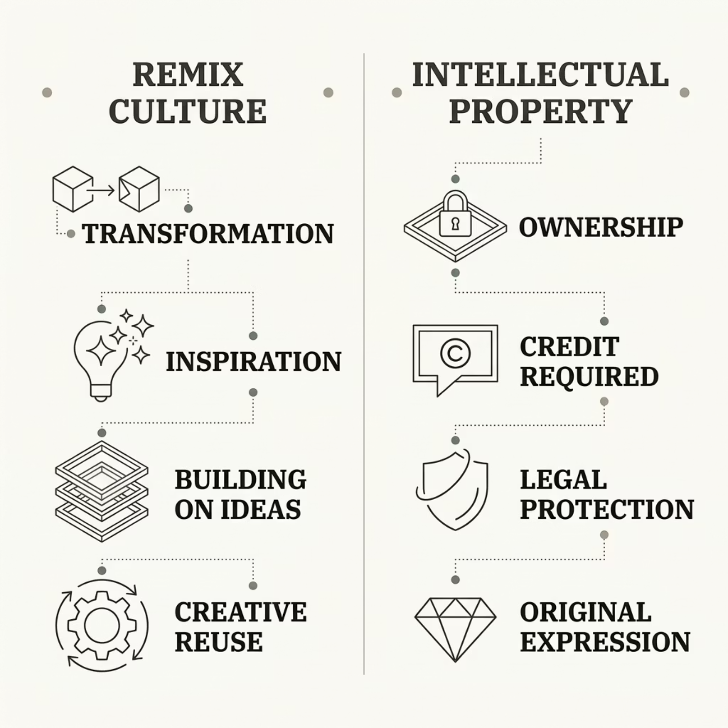
Remix Culture vs. Intellectual Property
The tension between remix culture and intellectual property is real. Artists, writers, and scholars are inspired by one another — but inspiration is not the same as copying.
The rule of thumb: transform it, cite it, or both. Inspiration is welcome; unacknowledged copying is not.

Slide 6

What Is Common Knowledge?
Common knowledge is information so widely known that it doesn't need a citation. You don't need to cite the fact that water boils at 100°C, or that World War II ended in 1945.
✅ Common Knowledge
Known by most people, found in many sources, not tied to one author or study.
📖 Cite It
Specific data, research findings, expert opinions, or unique interpretations require a citation.

Slide 7
Uniquely Framed Knowledge
Even when an idea is common, the way it is expressed can be unique. If a writer presents information in a distinctive, original way — through structure, metaphor, or argument — that framing belongs to them.
The Idea
May be general or widely known
The Frame
e.g. The fact that stress affects health is common knowledge. But a researcher's specific argument about how and why stress causes illness is uniquely framed — and must be cited.
The unique way it's argued or expressed
The Rule
If the framing is original, always cite it

Slide 8

How to Avoid Plagiarism
Take Notes
Use Quotes
Record sources and key details
Put direct quotes in quotation marks
Paraphrase
Review
Rewrite in your words and cite
Check citations before submitting
Good habits start early. When you research, track every source from the beginning — it's much harder to go back and find them later.

Slide 9
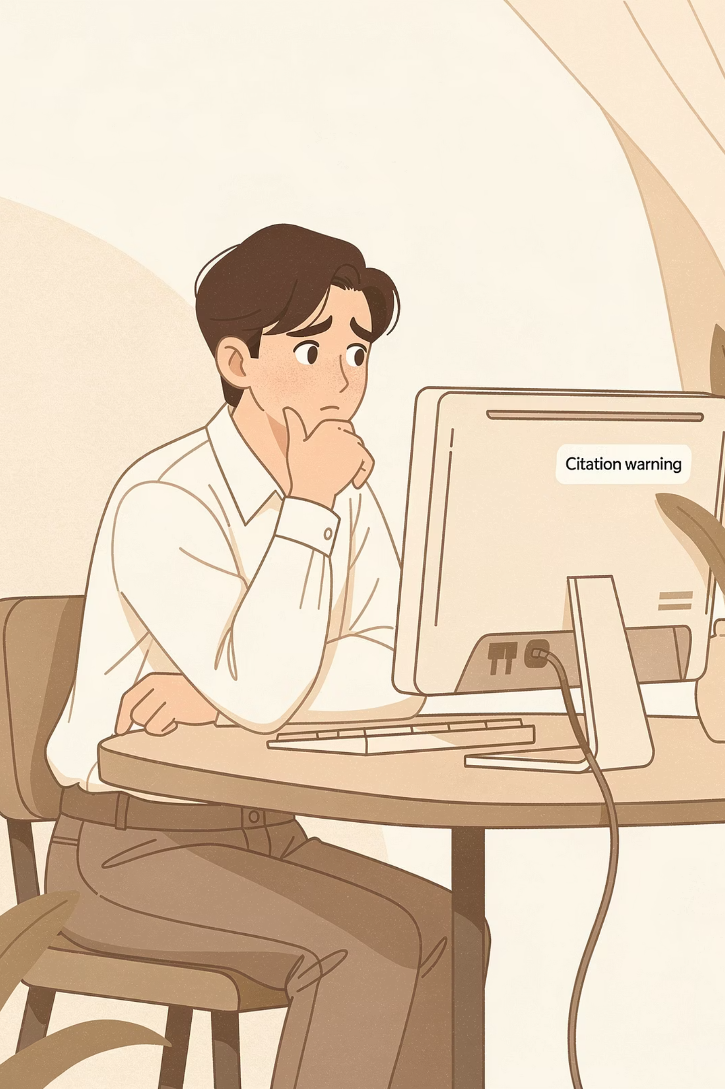
The Consequences Are Real
🎓 Academic
📋 Disciplinary
Failing the assignment, failing the course, or academic probation.
Formal review by an academic integrity board.
🚫 Long-Term
Suspension, expulsion, or a permanent mark on your academic record.

Slide 10

Key Takeaways
Ideas have owners
Know the 4 types
Always give credit — whether the source is a book, article, website, or even a classmate.
Intentional, accidental, patchwork, and self-plagiarism all carry consequences.
Remix ≠ copy
When in doubt, cite it
Inspiration is fine — but transformation and citation are required.
If something is uniquely expressed or argued, it needs a citation — full stop.

