Slide 1
WEDNESDAY
Bellringer
2026
7
We will be focusing on Critical Thinking and Argumentation for the following 6 weeks.
What do you remember about Rhetorical Devices?
What are the definitions of Ethos, Pathos, and Logos?
How can you disagree with others respectfully?
We Will: Establish classroom norms for respectful disagreement and define the three core rhetorical appeals (Ethos, Pathos, Logos).
I Will: Participate in a "This or That" debate by verbally justifying my choice using one specific rhetorical appeal.
Black or Blue Pen
Highlighter
Handout
Notebook/Pencil

Slide 2


Notes Expectations
In your notebook - Take a post-it note and mark the page you are starting on for Semester 2 notes. Write whats in RED.
Title page: Rhetorical Appeals
Subtitle: The Art Of Persuasion

Slide 3

Title: Rhetorical Appeals
Agenda:
Notes
Fact vs. Fiction
Used in conjunction (to connect 2 things) with Devices to persuade someone.
Logos: Logical approach - using facts, reasoning, and data.
Ethos: Building trust - using personal expertise, good character, and shared values.
Pathos: Emotional affect - causing the reciever to react in a emotional way using fear, joy, or anger.
Participation Expectations:
Write all the notes in RED
Notes:
Ethos Why should I trust you? (Badge, Uniform, Degree, Experience).

Slide 4
Rhetorical Identification
Agenda:
Notes
Identification of appeals
Fact vs. Fiction
Big Brother is watching you.
Oceania is at war with Eurasia, not Eastasia.
2+2=5. It has never been 4 according to Big Brother.
"Who controls the past controls the future: who controls the present controls the past."
If you want a picture of the future, imagine a boot stomping on a human face - Forever.
"Nothing was your own except the few cubic centimetres inside your skull."
Participation Expectations:
Identify appeals
Identify which appeals the speaker is attempting to use. Whether you know the information is correct or not.

Slide 5
Exit Ticket
Using your scrap paper - highlight the relevant information that tells you which appeal is being used and label them with Ethos, Pathos or Logos based on your highlighting.
"If you don't buy this, your puppy will be sad."
"As a doctor, I recommend this."
"This car gets 40 miles per gallon, saving you money."

Slide 6
Extension Activity - Practice Discussion -Safe Zone Expectations
Agenda:
- Social Contract
- Review classroom discussion rules.
- Practice DIscussion
Active Listening: We listen when others are speaking. We do not interrupt, talk over others, or use distracting body language.
Constructive Disagreement: We critique ideas, never the person. We disagree respectfully without personal attacks.
Zero Tolerance: We will not use language that is racist, sexist, homophobic, hostile, or derogatory.
Participation Expectations:
Classroom Movement
DIscussion
Answer questions.
Notes:
If there is time - I will move into notes for the next day.

Slide 7
Practice Discussion - Using Appeals
Agenda:
- Social Contract
- Review classroom discussion rules.
- Practice DIscussion
Discussion in class: Which do you think is better?
Topic 1: Cats or Dogs
Topic 2: Tacos or Pizza
Topic 3: Coffee or Energy Drinks
Participation Expectations:
Classroom Movement
DIscussion
Answer questions.
Instructions:
Move to one side of the room - Discuss with your group.
Challenge: You can not just say I Like it - You must use a logical statement, pathos statement, or ethos statement.
Notes:
If there is time - I will move into notes for the next day.

Slide 8
THURSDAY
Bellringer
2026
8
"Think of the last time you convinced your parents to let you go out or buy something. Did you use Emotion (crying/begging), Logic (showing grades/cost), or Credibility (reminding them you are responsible)? Which worked best?"
Write your answer on your Bellringer Document.
We Will: Analyze how authors use rhetorical devices to manipulate an audience and introduce Straw Man vs Steel Man..
I Will: Write detailed notes to explain Rhetorical Appeals, Logical Fallacies and Rhetorical Devices.
Notebook/Binder
Pencil (sharpened)

Slide 9
Rhetorical Devices
Agenda:
Notes
Identification of devices
Exit ticket Straw man vs. Steel man
We will be completing Rhetorical Devices notes. (slides 13-15)
Please Glue into your journal after you are done with your notes.
Complete the Card Sort with the person sitting next to you. Follow directions on slide 16.
These notes will be part of your notebook checks.
Participation Expectations:
Identify examples.
Write notes in the RED

Slide 10
Rhetorical Devices from Eng 1/2
Agenda:
Notes
Identification of devices
Exit ticket Straw man vs. Steel man
Alliteration: Repetition of initial consonant sounds. Ex. Sally sells seashells.
Hyperbole: Deliberate exaggeration. Ex. Tall as a tree.
Irony: contrast between expectation and reality.
Ex. Situational: Fire station burned down.
Ex. Verbal: It’s raining, and someone says, “Great, just what I needed!”
Participation Expectations:
Identify examples.
Write notes in the RED

Slide 11
What have you heard of before? ENG 1/2
What have you heard of before?
Juxtaposition: Placement of contrasting ideas side by side
Ex. Bombing of a boat of passagers, followed by exciting news.
Metaphor: Direct comparison between unlike things.
Ex. Love is a Battlefield
Motif: Repeated idea or image.
Ex. Eyes in a story can represent being watched.
Oxymoron: Two contradictory terms together. EX. Deafening SIlence in the room.

Slide 12
What have you heard of before? Eng 1/2
What have you heard of before?
Paradox: a statement that appears contradictory but makes sense. Ex. War is Peace, Freedom is Slavery. Ignorance is Strength.
Repetition: Repeated language to reinforce ideas. Ex. “Never forget. Never forgive. Never give up.”
Satire: the use of humor, irony, or exaggeration to critize real problems Ex. Political Cartoons around Election Time.
Symbolism: a single object representing an abstract/ larger idea Ex. Diary represents freedom

Slide 13
Identification of Examples
Complete the card sort with a partner - raise your hand when you are ready for it to be checked.

Slide 14
New Terms: Straw Man vs. Steel Man
What have you heard of before?
Straw Man: Misrepresenting an opposing argument to make it easier to attack
Ex. Person A: “We should have less homework.”
Person B: “So you’re saying students should never learn anything?”
Found Under Additional Concepts**
Steel Man - someone who is able to reasonably understand someones argument prior to responding using a logical and specific argument to strengthen the concept. Ex on Worksheet.
Notes:
Example to this statement is aligned to the exit ticket.

Slide 15
Straw Man vs. Steel Man Worksheet
Due today in class by the end of the period. Otherwise it is considered late.
All questions must be answered and legible - if I can’t read it, its a 0.

Slide 16
Exit Ticket
Complete the following exit ticket on your exit ticket paper and turn into the teacher.
Person A: “We should have less homework.”
Straw Man: “So you’re saying students should never learn anything?”
Complete the Steel Man part of the argument.

Slide 17
Friday
Bellringer
2026
9
Who is the most trustworthy person in your life? Why do you trust them?
***Use a Ethos Approach.
We Will: Define the four types of "Dystopian Controls" and identify them in media to prepare for reading 1984.
I Will: Participate in a "Safe Zone" discussion about Student IDs, comparing the policy to Driver's Licenses using evidence.
Notebook/Binder
Pencil (sharpened)

Slide 18
Friday
Alternative Bellringer
2026
9
"Would you live in a world with ZERO crime if it meant the government had to read all your text messages to catch the bad guys? Why or why not?"
**Answer using a Logical Approach**
We Will: Define the four types of "Dystopian Controls" and identify them in media to prepare for reading 1984.
I Will: Participate in a "Safe Zone" discussion about Student IDs, comparing the policy to Driver's Licenses using evidence.
Notebook/Binder
Pencil (sharpened)

Slide 19
Notes: Utopia Vs. Dystopia
Agenda:
Notes
Clip
TImeline Activity
Identify Controls.
Utopia: A place, state, or condition that is ideally perfect (politics, laws, customs).
Dystopia: A futuristic, imagined universe where societal control and the illusion of a perfect society are maintained through strict control.
Participation Expectations:
Write in your journal

Slide 20
Notes: Utopia Vs. Dystopia
Agenda:
Notes
Clip
TImeline Activity
Identify Controls.
The 4 Types of Dystopian Control:
Corporate Control: One or more large corporations control society through products/advertising (e.g., Wall-E).
Bureaucratic Control: Society is controlled by a mindless tangle of red tape, relentless regulations, and incompetent government officials (e.g., Brazil).
Participation Expectations:
Write in your journal

Slide 21
Notes: Utopia Vs. Dystopia
Agenda:
Notes
Clip
TImeline Activity
Identify Controls.
The 4 Types of Dystopian Control:
3. Technological Control: Society is controlled by computers, robots, or scientific means (e.g., The Matrix, 1984 Telescreens).
4. Philosophical/Religious Control: Society is controlled by philosophical or religious ideology enforced by a dictatorship (e.g., The Handmaid's Tale).
Participation Expectations:
Write in your journal

Slide 22
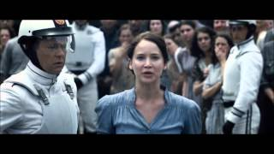
Title: Hunger Games Clip
Agenda:
Notes
Clip
TImeline Activity
Identify Controls.
Expectations - Look for Dystopian Controls that we just talked about.
Bureaucratic
Corporate
Philisophical
Technological
Participation Expectations:
Stay quiet and take notes.
Discussion: What Controls did you see and what type of dystopian society do you think this is?

Slide 23
Fact vs. Fiction
Agenda:
Notes
Clip
TImeline Activity
Identify Controls.
Using the Cards in Front of your group - determine whether you think this is a fictional plot theory or a historical fact.
Determine a reason or two - why you think this. Be prepared to discuss.
Once you have determined your answer, Give a thumbs up. 👍
Extension Activity: Identify the Control that is being exercised based on Dystopian Controls.
Participation Expectations:
Discuss with your group.
Group Answer to class.

Slide 24
Fact vs. Fiction Answers
Agenda:
Notes
Clip
TImeline Activity
Identify Controls.
Lets look at these descriptions and determine fact vs. fiction
The "Un-Person"
The Invisible Bomb
The Child Spies
The Mutability of Truth
The World Split
The Ultimate Weapon
Participation Expectations:
Discuss with your group.
Group Answer to class.
Notes:
1- Un-Person: Event: Stalin's "Great Purge"
Date: 1936–1938
Context: Joseph Stalin executed nearly 700,000 citizens. The NKVD (secret police) then modified photos and texts to erase them. Orwell called this "Vaporization."
2- Invisible Bomb: Event: The V-2 Rocket
Date: 1944
Context: Nazi Germany fired over 3,000 ballistic missiles at London. Orwell lived in London during this. They inspired the "Rocket Bombs" in 1984.
3- Child Spies: Event: The Hitler Youth / Soviet Pioneers
Date: 1930s–1940s
Context: Both Nazis and Soviets encouraged children to denounce their parents. In 1984, this is the "Junior Spies" league.
4- The Truth: Event: The Spanish Civil War
Date: 1937
Context: Orwell fought in this war and watched newspapers print lies about battles he saw with his own eyes. This inspired "Doublethink" and the Ministry of Truth.
5- The World Split: Event: The Tehran Conference
Date: 1943
Context: Churchill, Roosevelt, and Stalin met to divide the post-war world. This inspired the three superstates: Oceania, Eurasia, and Eastasia.
6- Ultimate Weapon: Event: The Atomic Bomb (Hiroshima)
Date: 1945
Context: The bomb changed warfare forever. In 1984, the superstates had these bombs but didn't use them—using the threat to control their own people instead.

Slide 25
Fact vs. Fiction Dystopian Controls
Agenda:
Notes
Clip
TImeline Activity
Identify Controls.
Lets look at these descriptions and determine dystopian controls.
The "Un-Person"
The Invisible Bomb
The Child Spies
The Mutability of Truth
The World Split
The Ultimate Weapon
Participation Expectations:
Discuss with your group.
Group Answer to class.
Notes:
Bureaucratic Control
Bureaucratic control
Philisophical/Religious beliefs
Bureacratic Control/ Corporate Control
Bureaucratic Control
Bureaucratic Control/ Corporate control based on creation of the bomb.
Students should find that most are control by the government

Slide 26
Fact vs. Fiction Timeline
Agenda:
Notes
Clip
TImeline Activity
Identify Controls.
Lets look at these descriptions and put them in timeline order.
The Child Spies 1930-1940
The Mutability of Truth 1937
The "Un-Person" 1936-1938
The World Split 1943
The Invisible Bomb 1944
The Ultimate Weapon 1945
Participation Expectations:
Discuss with your group.
Group Answer to class.

Slide 27
Classroom Discussion
This is a Safe Zone: Don’t speak over others, Raise your hand to speak, Disagree respectfully, and no derogatory language. Use Pathos, Ethos, or Logos Effectively.
Discussion Topic: "Should students be required to wear ID badges visible at all times during school?"
Take a minute or two to write down your argument and thoughts.

Slide 28
Exit Ticket
Using your exit ticket -
"Choose one of the 4 Dystopian Controls (Corporate, Bureaucratic, Tech, Philosophical). Underline it!!
Explain how Student ID Badges could be seen as an example of that control."

Slide 29
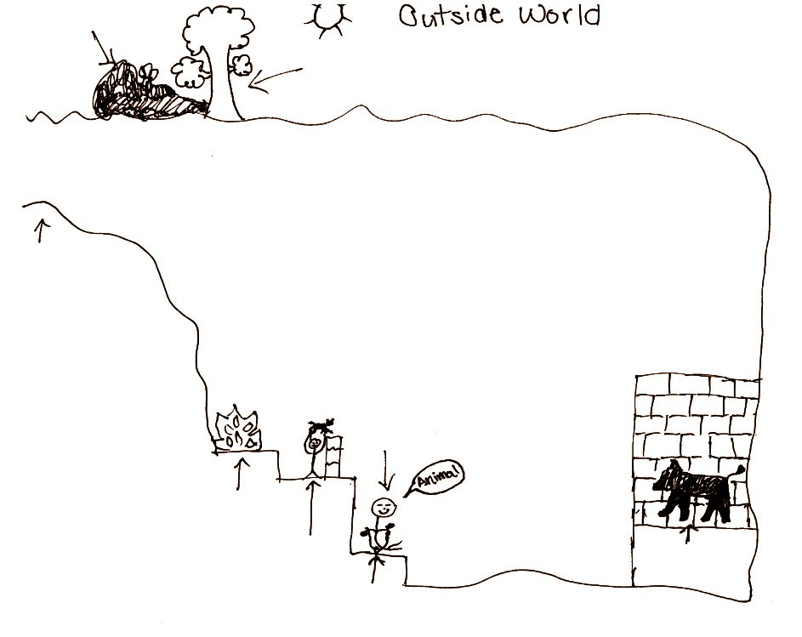
Allegory of the Cave Recap
Agenda
Allegory of the Cave
Modern Concepts
Label and Define the following on your image: Shadows, Chains, Fire, Puppeteer, Prisoner, Sun, Reality, False Reality, Enlightenment.
Participation expectations: Follow along with notes.

Slide 30
Allegory of the Cave Recap
Agenda
Allegory of the Cave
Modern Concepts
In your Chart complete the following notes:
The Symbol | Part 1: Meaning
The Shadows
The Chains
The Fire
The Puppeteers
The Sun
False reality/ Only reality a prisoner can see without enlightenment
Controls the ability to make a change
Participation expectations: Write all of the red in your notes.
A tool to create a false reality
Creates a false reality to make the prisoner feel comfortable and understood.
Reality that is only attained through pain and enlightenment.

Slide 31
Allegory of the Cave Recap
Agenda
Allegory of the Cave
Modern Concepts
On the back of your paper - Answer the following questions based on your dystopian controls notes:
What dystopian control is Plato emphasizing in his Allegory of the Cave?
Bureaucratic, Corporate, Technological, Philisophical
Participation expectations: complete your worksheet

Slide 32
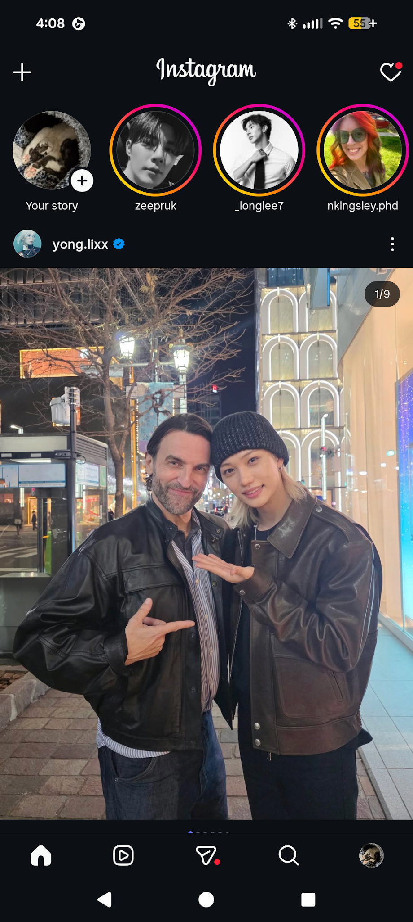
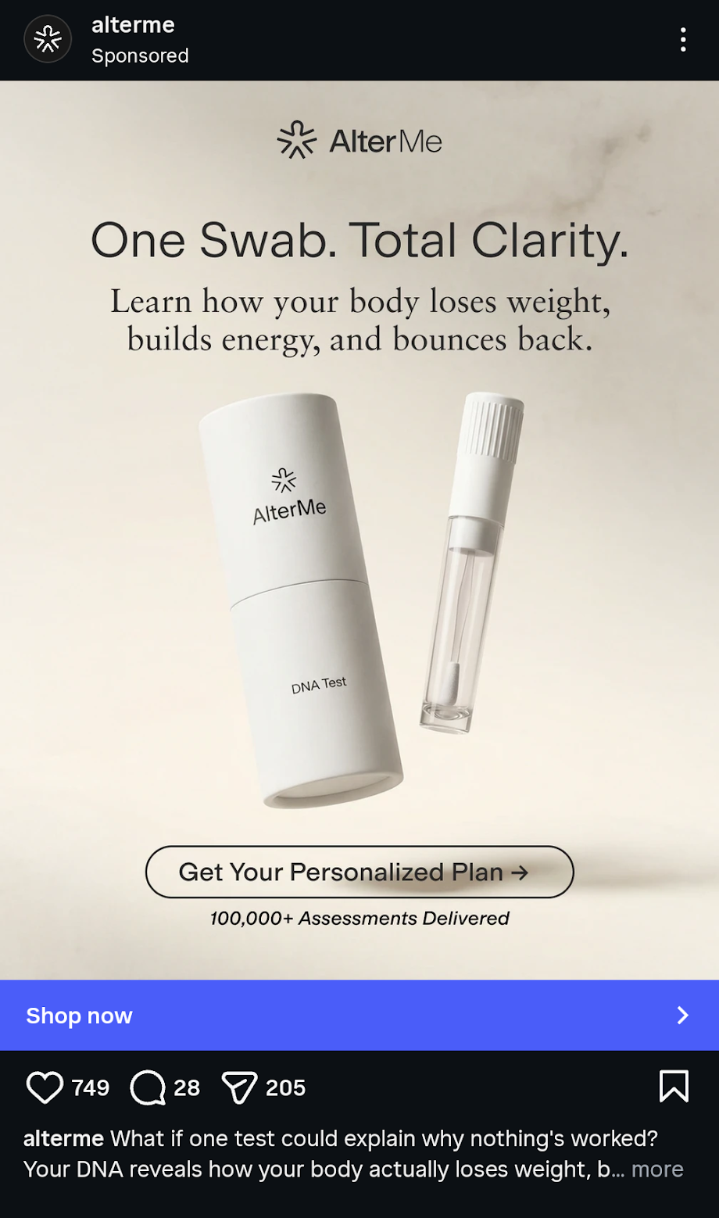
Modern Concepts
When you open your Instagram account - what do you usually see first?
Your favorite creators?
Sponsored ads?
Reels?
What is the false reality you
See?
Complete the back of your worksheet using the modern example of instagram

Slide 33
Exit Ticket
Why do you think the prisoner experienced pain when he first attained enlightenment? AKA - sunlight in his eyes.

Slide 34
Tuesday
Bellringer
2026
13
Who is easier to control: A person who thinks with their head (logic), or a person who thinks with their heart (emotion)? Explain your answer with an example from real life (advertising, politics, or relationships).
On your Bellringer sheet write in a complete sentence.
We Will: Deconstruct propaganda images to identify how Ethos, Pathos, and Logos are used to manipulate human behavior.
I Will: Analyze a specific war poster (or the Big Brother poster description) and identify the primary rhetorical appeal used to silence dissent.
Notebook
Book - 1984
Pencil

Slide 35
Allegory of the Cave Recap
Agenda
Allegory of the Cave
Modern Concepts
In your Chart complete the following notes:
The Symbol | Part 1: Modern Social Media
The Shadows
The Chains
The Fire
The Puppeteers
The Sun
A celebrity being happy online every day.
My Feed or Personal Algorithm.
Participation expectations: Write all of the red in your notes.
Instagram
Creators, advertisers and content makers
The ability to fact check something by looking it up on another reputable website.

Slide 36
Notes: Utopia Vs. Dystopia
Agenda:
Notes
Clip
TImeline Activity
Identify Controls.
Utopia: A place, state, or condition that is ideally perfect (politics, laws, customs).
Dystopia: A futuristic, imagined universe where societal control and the illusion of a perfect society are maintained through strict control.
Participation Expectations:
Write in your journal

Slide 37
Ad Populum - Bandwagon Effect
Pathos Foldable -
Ad Populum: Claiming something is true, good and valid because many people believe it, like it or do it. Ex. “67” Bandwagon
Ad Baculum: Force, threats, or intimidation are used to compel an audience. Ex. “You better listen to me or else. ”

Slide 38
Ad Populum - Bandwagon Effect
Pathos Foldable -
Gaslighting: Targeting and exploiting emotions through denial of facts, twisting the narrative and creating self doubt in a victim. EX. lying about an action, even if you did it.

Slide 39
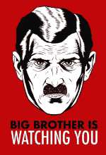
Visual Propaganda vs. Textual
Agenda
Visual vs Textual
OPTIC
Rhetorical Analysis
Which do you feel is more effective?
“On each landing, opposite the lift-shaft, the poster with the enormous face gazed from the wall. It was one of those pictures which are so contrived that the eyes follow you about when you move. BIG BROTHER IS WATCHING YOU, the caption beneath it ran.”
Participation expectations.
Complete independent analysis with discussion.

Slide 40
Create in your Journal
Agenda
Visual vs Textual
OPTIC
Rhetorical Analysis
Overview:
Parts:
Title:
Inference:
Conclusion:
Rhetorical Appeal:
Participation expectations.
Complete independent analysis with discussion.

Slide 41

OPTIC + Rhetorical Appeal
World War II Propaganda Poster
Overview | Hand in water sinking
Parts | hand,hat,water,slogan
Title | Loose Lips Sink Ships
Inference | A man drowning bc he told the enemey
Conclusion | Dont talk about the us military
Rhetorical Appeal | pathos

Slide 42

OPTIC + Rhetorical Appeal
World War II Child Spies Propanda
Overview | Nazi child
Parts | Nazi flag, people happy,happy child,building
Title | Hitler Youth
Inference | Be a patriot like this child
Conclusion | Be proud of the nazi culture
Rhetorical Appeal | Pathos pride

Slide 43
OPTIC + Rhetorical Appeal
1984 Propaganda Poster
Overview | Staring man
Parts | Red,man,angry face
Title | Big Brother is Watching You
Inference | You are being watched 24/7
Conclusion | Be on your best behavior
Rhetorical Appeal | Pathos - angry

Slide 44
Reading 1984
What types of Rhetorical Appeals are being used against Winston in the first few pages.
Write notes to answer this question. (exit ticket)
Which rhetorical appeal is most used by The Party and do you believe it is effective or ineffective? Why? Use text evidence to support your answer. 3-5 sentences.

Slide 45
Exit Ticket
Write notes to answer this question. (exit ticket)
Which rhetorical appeal is most used by The Party and do you believe it is effective or ineffective? Why? Use text evidence to support your answer. 3-5 sentences.

Slide 46
Wednesday
Bellringer
2026
14
Describe a place you have been that made you feel overwhelmed, tired, or ready to crash out just by being there. What specifically about the place (smell, lighting, temperature) made you feel that way?
On your Bellringer sheet write in a complete sentence.
We Will: Conduct a "Sensory Audit" of Airstrip One to determine how the setting influences the mood of the novel.
I Will: List three specific sensory details (smell, sight, touch) from Chapter 1 and explain what they reveal about the quality of life in Oceania.
Notebook
Pencil
Book

Slide 47
OPTIC + Rhetorical Appeal
1984 Propaganda Poster
Overview | Staring man
Parts | Red,man,angry face
Title | Big Brother is Watching You
Inference | You are being watched 24/7
Conclusion | Be on your best behavior
Rhetorical Appeal | Pathos - angry

Slide 48
Reading 1984
What types of Rhetorical Appeals are being used against Winston in the first few pages.
Write notes to answer this question. (exit ticket)
Which rhetorical appeal is most used by The Party and do you believe it is effective or ineffective? Why? Use text evidence to support your answer. 3-5 sentences.

Slide 49
Exit Ticket
Write notes to answer this question. (exit ticket)
Which rhetorical appeal is most used by The Party and do you believe it is effective or ineffective? Why? Use text evidence to support your answer. 3-5 sentences.

Slide 50
In your Journal
Agenda
Sensory Audit of 1984
Discussion
Exit Ticket
Reading HW
Create the following Table: ⅓ page
Smell | Sight | Touch
Old rugrats Boiled cabbage | Giant poster Telescreen helicopter | Lightswitch stairs
Participation expectations.
Write 1-2 examples for each.

Slide 51
Discussion Questions
Agenda
Sensory Audit of 1984
Discussion
Exit Ticket
Reading HW
Answer the comprehension questions from your handout on a blank page of your journal.
Make sure you label the page as Chapter 1 - and answer the questions.
Glue in or Staple the questions into your journal on the page or after.
Participation expectations
Write in your journal - be prepared to discuss with the class.

Slide 52
Paradox
Paradox: a statement that appears contradictory but makes sense. Ex. War is Peace, Freedom is Slavery. Ignorance is Strength.
Propaganda: Eliciting an biased response to a person, place or thing. EX. Hitlers Youth Spies - children who joined a club because they were told it make them better citizens.
Appeal to Authority: Claiming something is true because someone with credentials said it is. EX. Trusting a doctor on a commercial that a product is safe.

Slide 53
Exit Ticket
Orwell describes the hallway smelling of 'boiled cabbage.' Does this world feel (sensory details) like a futuristic dystopian novel? Why or why not? Provide text evidence to support your answer.
When done, turn in your exit ticket to the teacher.

Slide 54
Thursday
Bellringer
2026
15
"Why is it satisfying to dislike the same person that your best friend dislikes? Does sharing a common 'enemy' make a friendship stronger? Explain."
On your Bellringer sheet write in a complete sentence.
We Will: Analyze the psychological purpose of the "Two Minutes Hate" to understand how regimes use a common enemy to unify their citizens.
I Will: create a T-chart to show the differences in the main character and how it influences the double think concept.
Notebook
Pencil
Book

Slide 55
Scapegoat
Agenda
Notes
Reading/ Analysis
Questions 4-6
What is a Scapegoat?
an individual or group unfairly blamed for the faults or problems of others
Theory states that if a society is unstable, you can unit them using a common enemy.
Example - The Holocaust and the Jews.
Participation expectations.
Write notes in Red

Slide 56
Read pages 5-11
Agenda
Notes
Reading/ Analysis
Questions 4-6
4. Exigency: Winston decides to start a diary, which could get him killed. What is the exigency (the immediate need) that forces him to take this risk right now?
5. Audience Reaction: In the movie theater scene Winston describes, the audience laughs at war refugees being killed. What does this reaction tell us about the ethical appeal (ethos) or morals of this society?
6. Reliable Source: Is Winston a reliable source when he talks about the past? Why might his memory be considered "unreliable" in this specific context?
Participation expectations.
Listen to Pages 5-11.

Slide 57
Friday
Bellringer
2026
16
When given this prompt - how can you create a claim statement or a thesis statement -
"Do people follow the laws (like speed limits or school rules) because they believe they are right, or because they are afraid of getting caught?
On your Bellringer sheet write in a complete sentence.
We Will: Synthesize our understanding of Week 1 by writing a Short Answer Response (SAR) using text evidence.
I Will: Draft a paragraph answering the prompt: "Does the Party control people more through physical force or psychological fear?" using at least one embedded quote.
Pencil
Lined Paper
Notebook

Slide 58

Notes quiz
Agenda
Notes
Reading/ Analysis
Questions 4-6
Complete the Note quiz and then watch the video posted on Google Classroom.
Participation expectations.
Listen to Pages 5-11.

